Slide 1
Covid-19: A Quick Overview to The Current Pandemic in Mexico
Members:
Odin Del Toro
Bernardo Jardon
Miguel Bonachea
Pablo Arroyo

Slide 2
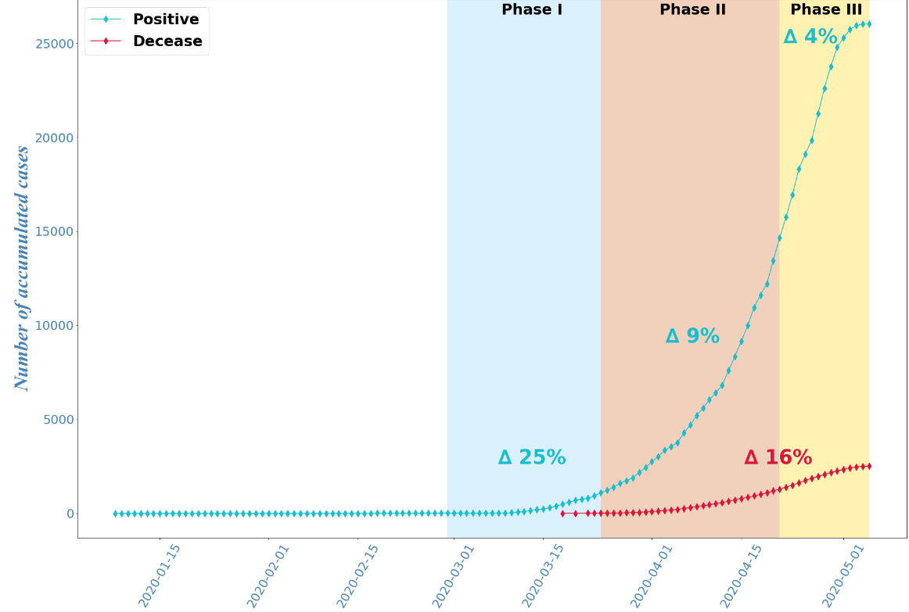

Covid – 19: Disease Overview
Background Information
Covid-19 Current Rate of Transmission of 4%
Name
Virus: SARS-COV-19
Disease: CO VID 19
Corona
Virus
Disease
2019
Transmission
Spreads through droplets when we sneeze, cough or speak
Can enter us directly through our eyes, nose or mouth
The virus can also life on a lot of surfaces for hours so anyone can pick it up on their hands and infect themselves when touching their face (~500 times a day)
You can be infected and not have any symptoms
Data as of May 5
Disease Timeline Summary:
Per 1MM
Total Test Performed
(#,K)
Population
(MM)
Jan 1: China reported a cluster of cases of pneumonia
Jan 27: First Covid-19 case in Mexico
Mar 24: Stage 2 starts: Local disease transmission
Brazil
735
210
3.5
Peru
587
32
19
Mexico
536
127
4.2
Jan 5: WHO published the first disease outbreak news
Mar 18: First death due to Covid-19
April 21: Stage 3 starts: Thousands of cases in different regions across the country
Argentina
94
45
2.1
1

Slide 3

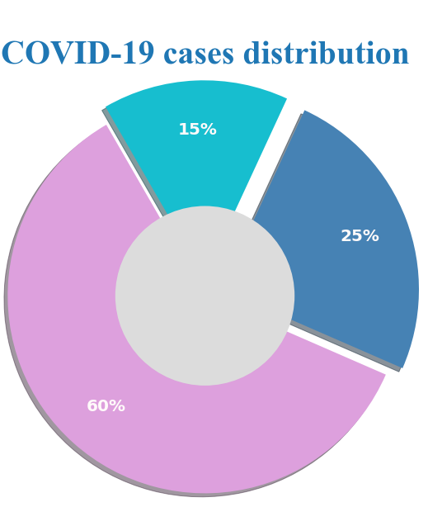
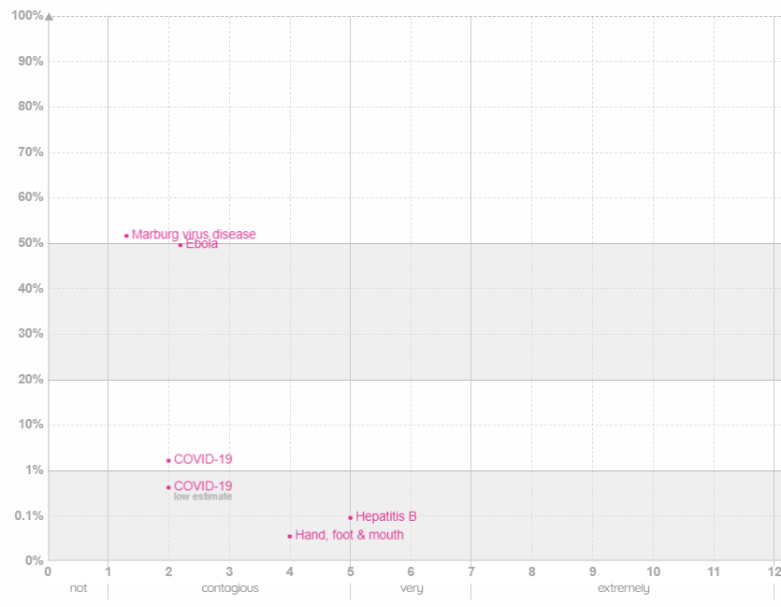
Covid – 19: How Contagious It Can Be?
Covid-19 Cases Distribution
Is it More Contagious than Other Pandemics?
As of today it is not clear yet, it is deadlier than Measles but less contagious. Far less deadly than Ebola but no were near Smallpox
25% of tested cases are positive
2
Source: information is beautiful. (2020). The MicrobeScope – Infectious Diseases in Context. [Scatter Plot Visualization]. informationisbeautiful.net.
https://informationisbeautiful.net/visualizations/the-microbescope-infectious-diseases-in-context/
Notes:
https://informationisbeautiful.net/visualizations/the-microbescope-infectious-diseases-in-context/

Slide 4
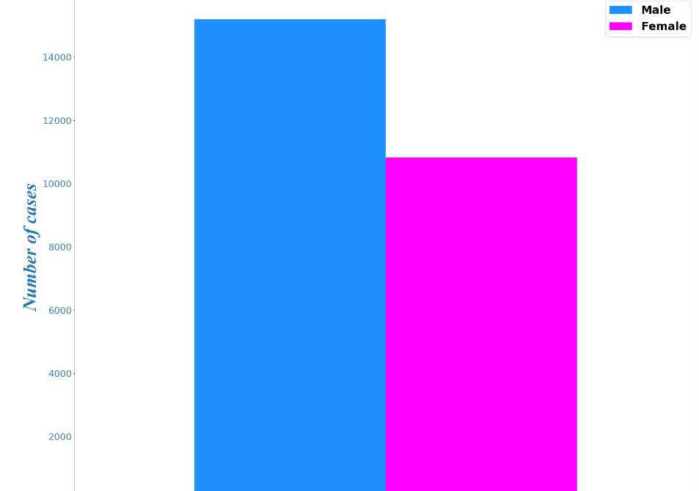



Covid – 19: No Clear Answer as to Who is More Prune to Get Infected
Women or Men?
There is no clear understanding why the risk is higher for men.
Some hypothesis are:
+40% compared to women population
Biological Factors
Men are more likely to smoke
A greater percentage of woman wash their hands
3

Slide 5
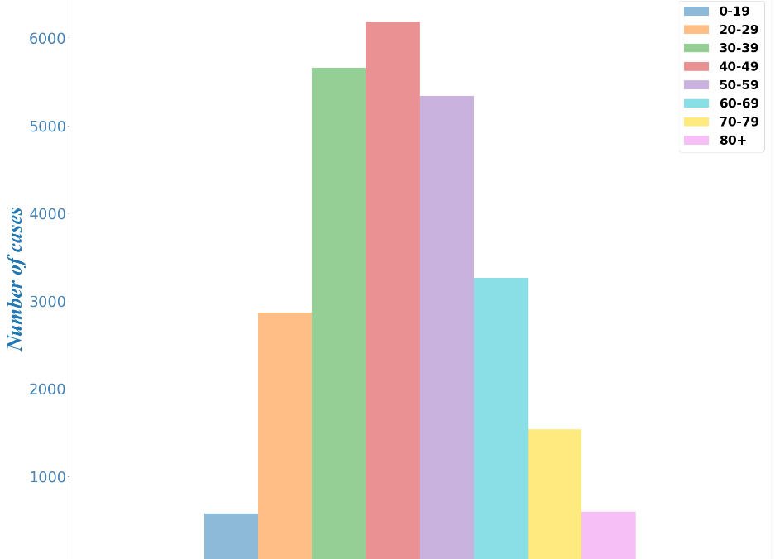
Covid – 19: Is Age a Defining Factor to Getting Infected?
Positive Covid-19 Age Distribution is Very Similar to Overall Population Distribution
Coronavirus Mystery: Children seem less susceptible to the disease
4
Notes:
https://www.sciencealert.com/experts-are-puzzled-over-why-so-few-children-have-caught-coronavirus-so-far
The outbreak was first reported on December 31, but no children younger than 15 years old had been diagnosed as of January 22. A study in the New England Journal of Medicine said at the time that "children might be less likely to become infected or, if infected, may show milder symptoms" than adults.
Since then, doctors have recorded a few one-off cases among children: a 9-month-old girl in Beijing, a child in Germany whose father was diagnosed with the virus first, and a child in Shenzhen, China, who was infected but displayed no symptoms.
On Wednesday, Chinese authorities confirmed that an infant in Wuhan, China, had tested positive for the virus 30 hours after being born; the baby's mother is a coronavirus patient.
But for the most part, kids do not seem very vulnerable to the virus.

Slide 6
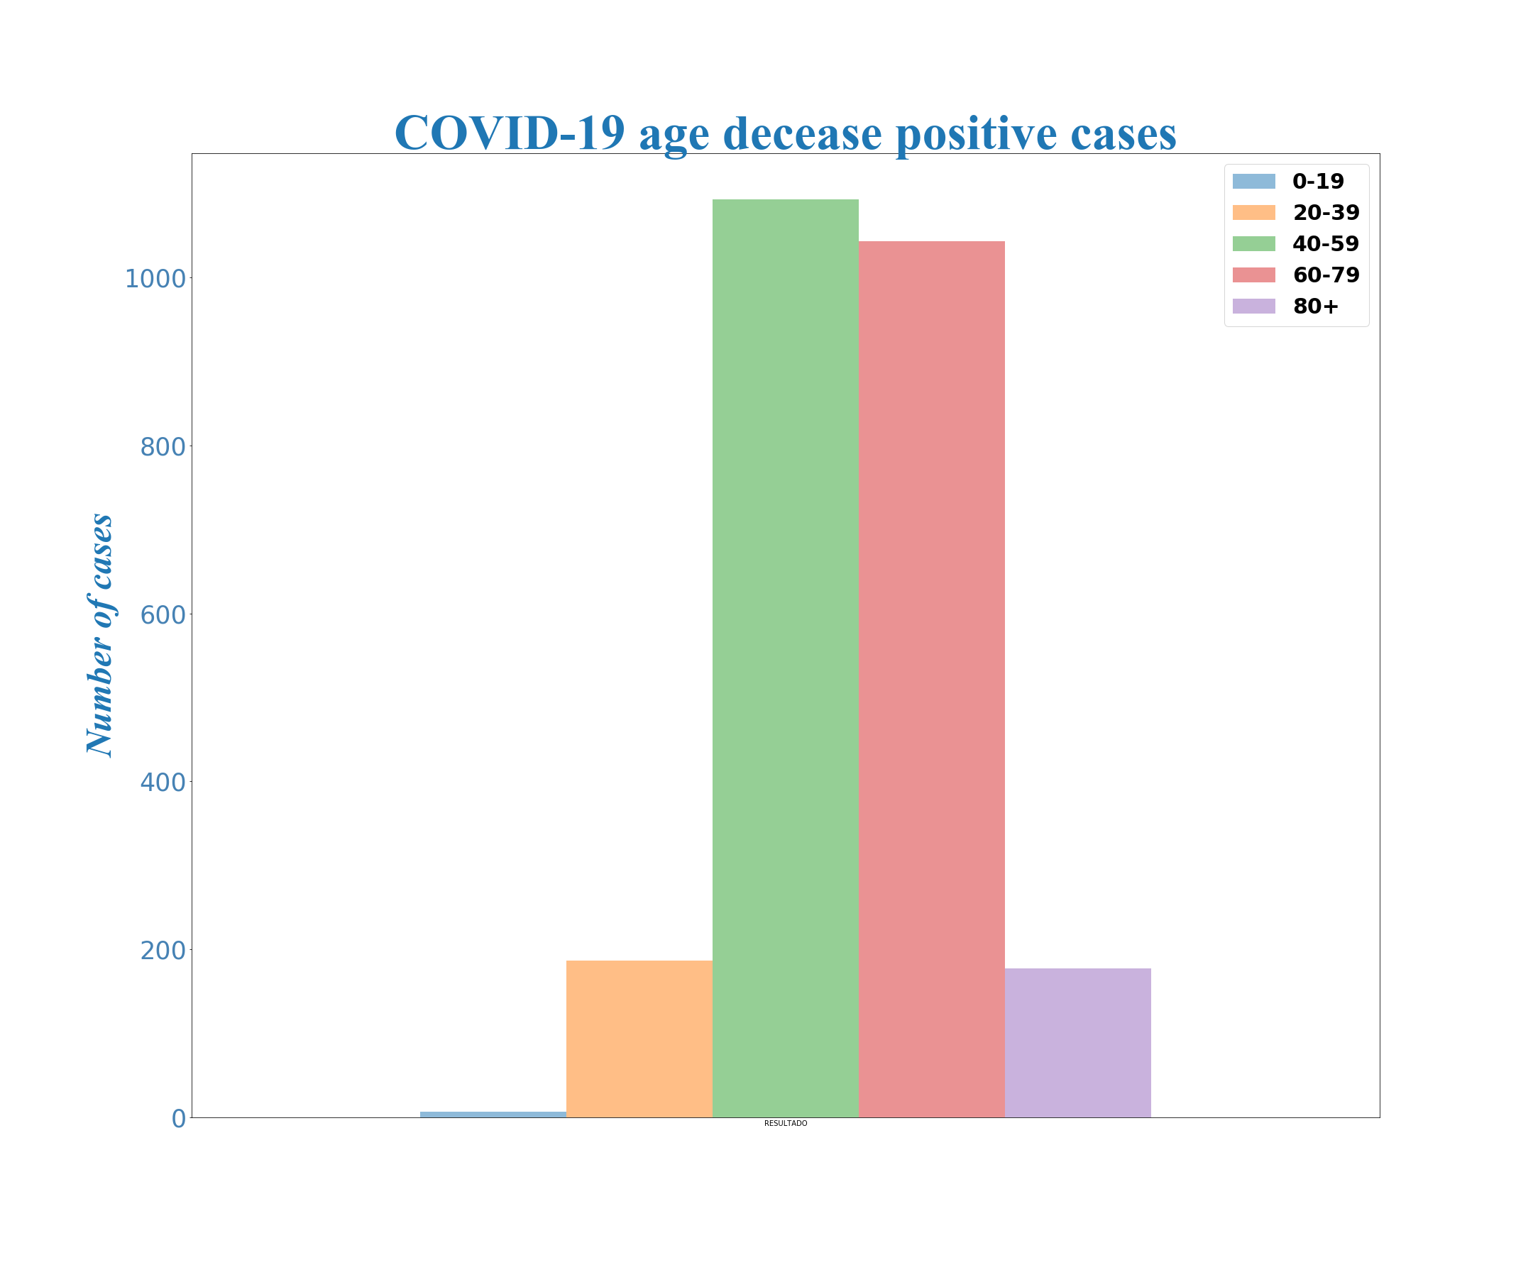
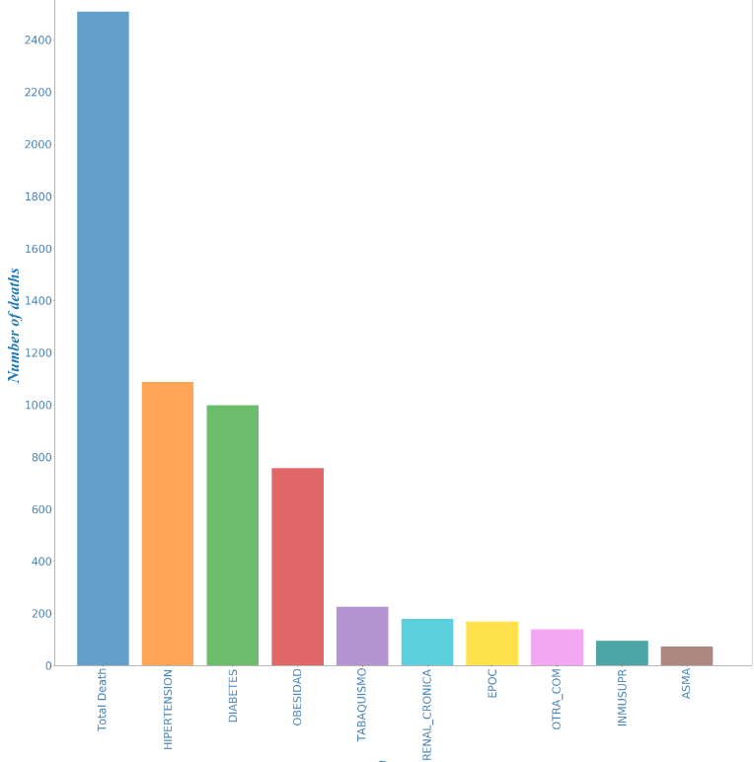
Covid – 19: Mild for Some, Deadly for Others (1/3)
Age & Pre-Existing Conditions
Age
A recent study examined data from individuals who tested positive for COVID-19 in 38 countries and found that risk of death from the disease rose with each decade of age
Pre-Existing Conditions
During current global pandemic, physicians require guidance for their patient populations in order to adequately balance the risk of exposure with the harms of withholding or delaying care
6
Notes:
https://abcnews.go.com/Health/risk-severe-covid-19-increases-decade-age/story?id=69914642
https://health.ebsco.com/blog/article/considerations-for-covid-19-in-patients-pre-existing-high-risk-conditions

Slide 7
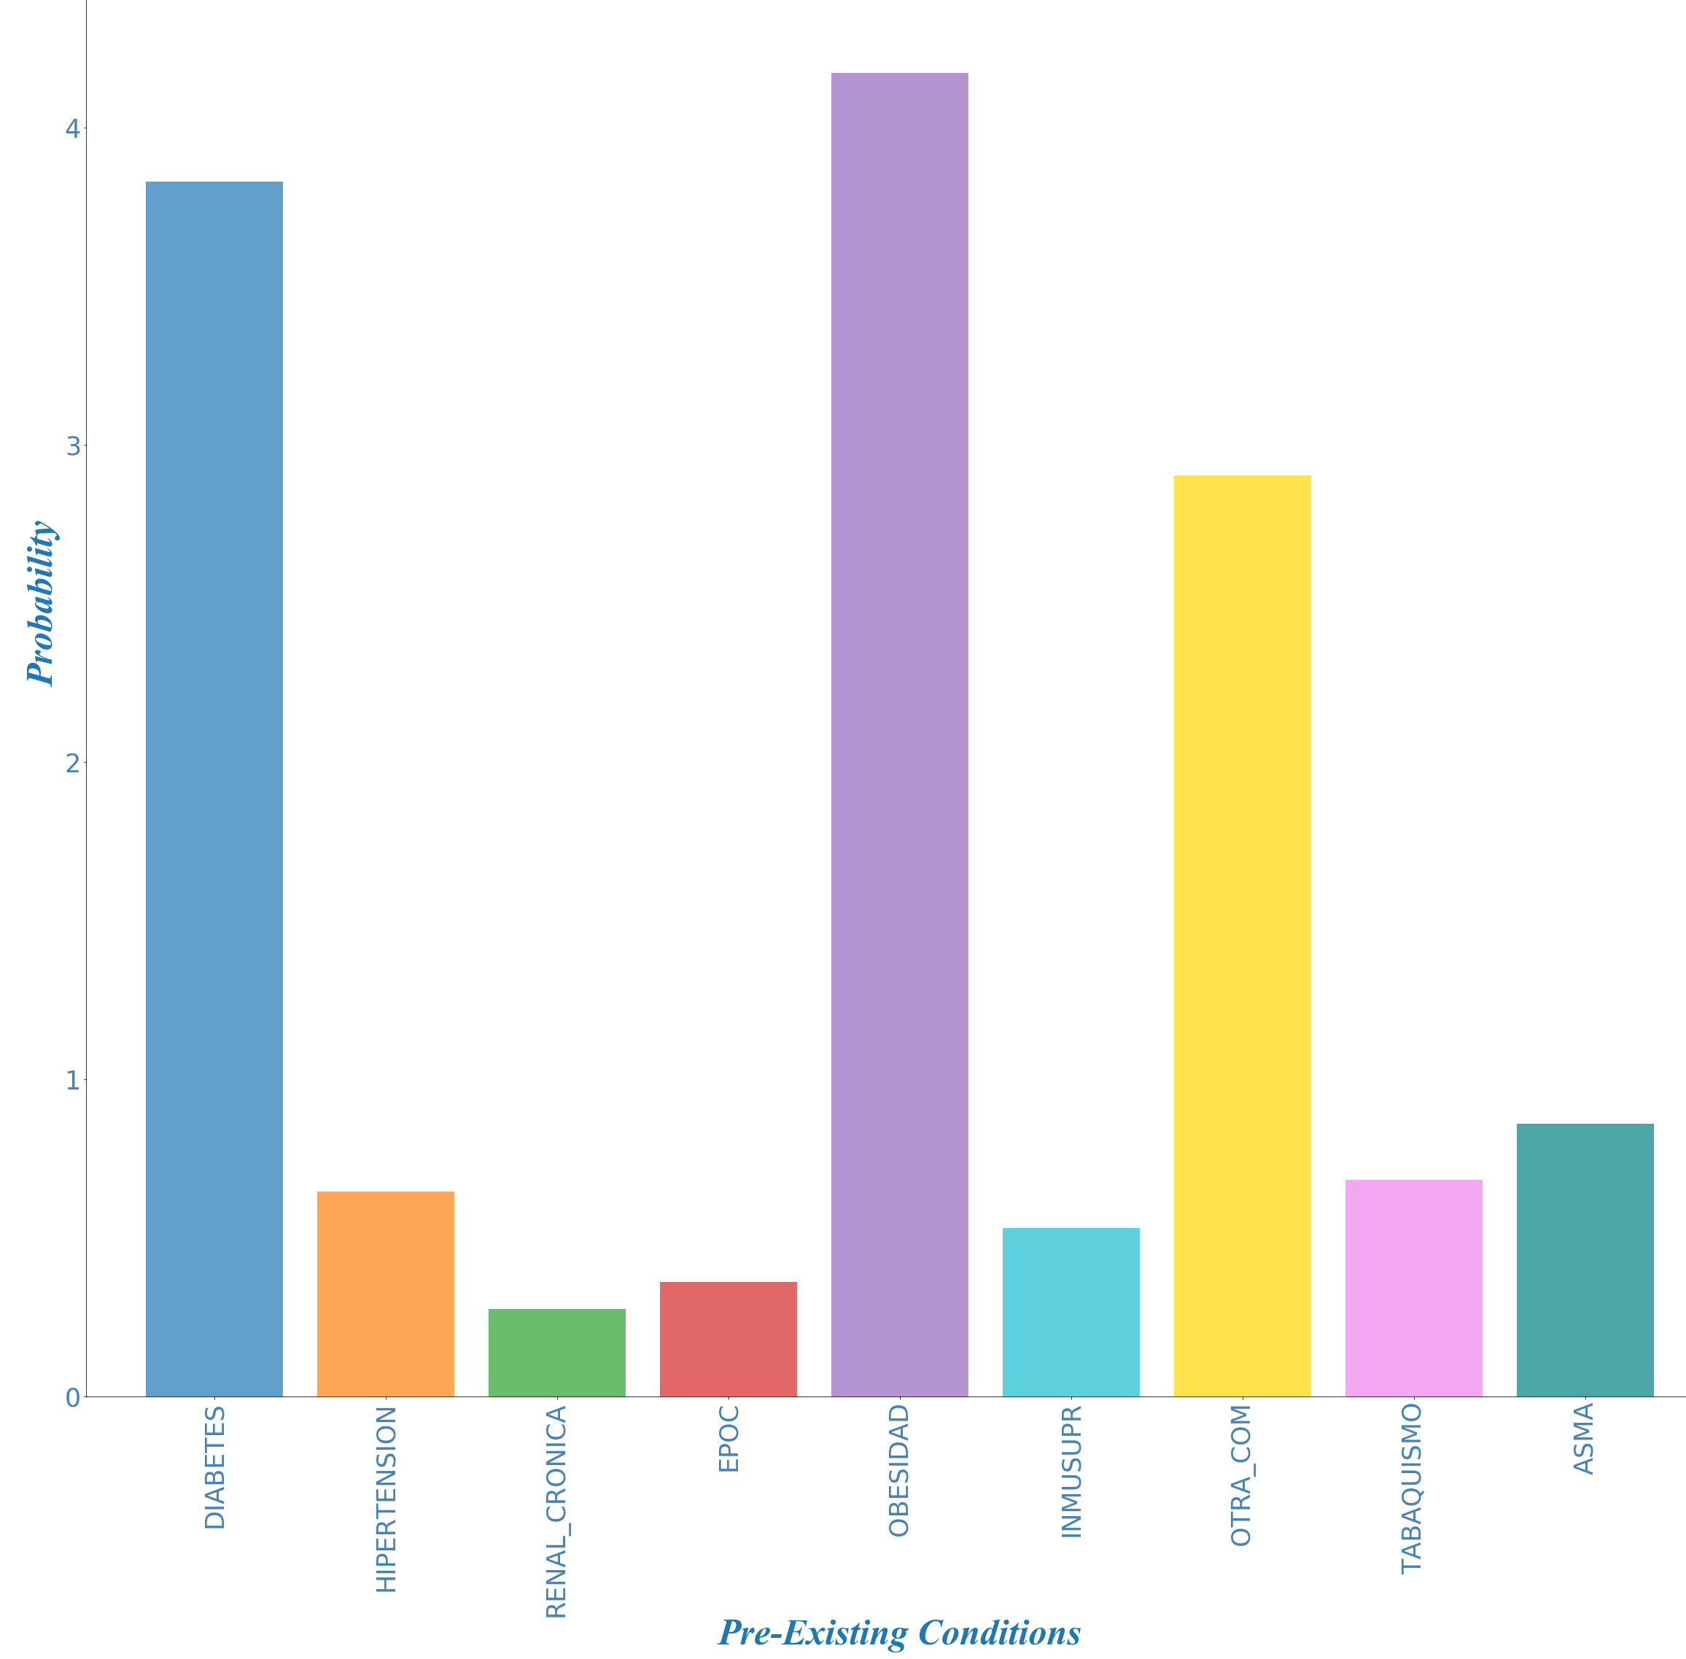
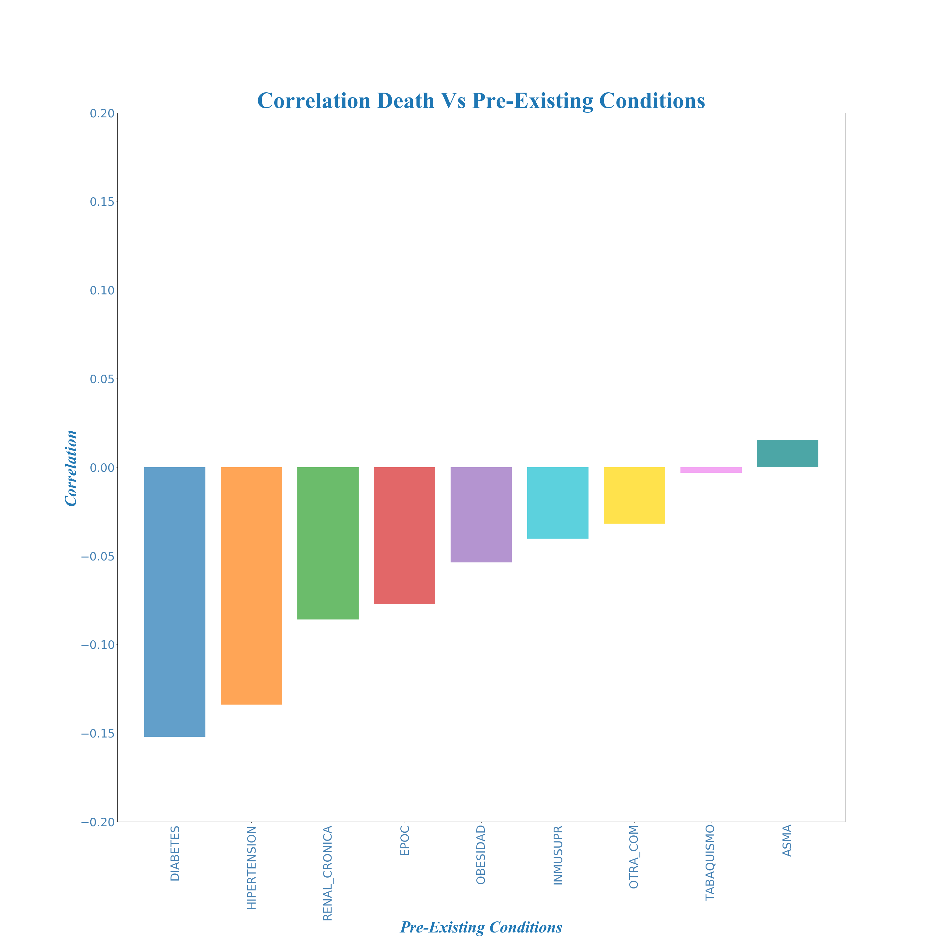
Covid – 19: Mild for Some, Deadly for Others (2/3)
Increase In Death Probability Due to Pre-Existing Conditions
Pre-Existing Conditions Vs Death Correlation
7

Slide 8

Covid – 19: Mild for Some, Deadly for Others (3/3)
Density per State
Death rate
9%
12%
2%
High population density cities
16%
19%
20%
17%
21%
11%
28%
15%
26%
9%
30%
26%
18%
24%
22%
8%
30%
Social distance is key to stop the spread of the disease. More populated cities will have higher rates of infections and people have a higher degree of interaction than in less populated ones
5

Slide 9
Covid – 19: Deadliest Variable, Health Care Overcapacity
Mortality Rate per State
Mortality rate
52%
33%
30%
30%
30%
30%
29%
26%
26%
24%
23%
21%
21%
20%
20%
20%
20%
19%
18%
17%
8

Slide 10
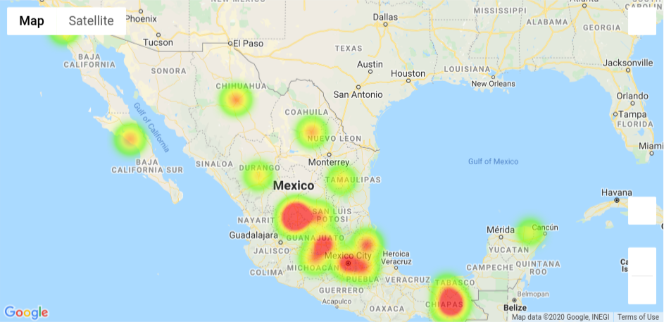
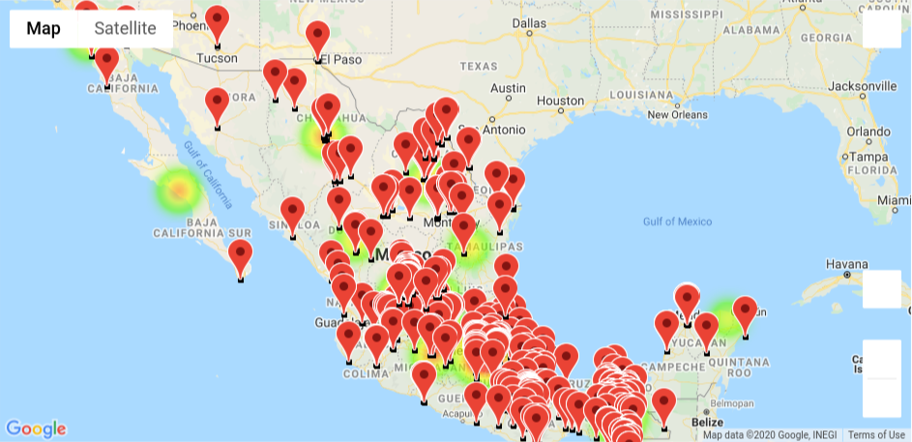
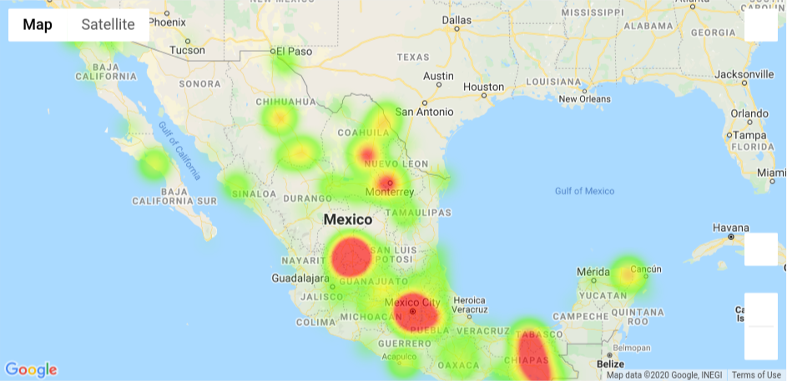

Covid – 19: How Is The Disease Spread Across Mexico
CDMX Has The Highest Number of Infections and Deaths
Demand For Medical Health Care is Surpassing the System Capacity
Covid-19
Infections
Hospital Locations
Deaths Due To
Covid-19
Saturation in hospitals serving patients with coronavirus in CDMX
El Economista
42 Hospital in Valle have no availability for patients with Covid-19
Expansión
9
Maps created with Google API
Notes:
https://www.eleconomista.com.mx/politica/Saturacion-en-hospitales-que-atienden-a-pacientes-con-coronavirus-en-CDMX-durante-pico-de-contagio-20200509-0021.html
https://politica.expansion.mx/cdmx/2020/05/12/sin-disponibilidad-42-hospitales-del-valle-de-mexico-para-pacientes-covid-19

Slide 11
Conclusions:
1
Covid-19 is a virus that has a high rate of transmission
2
Younger population tend to have lower rate of infections
3
Age and Respiratory pre-conditions increases the probability of death
4
The health system could reach a point of oversaturation, which could cause an increase in the mortality rate
10

Slide 12
Thanks!
& Stay At Home

